Slide 1


RN SHETTY TRUST®
RNS INSTITUTE OF TECHNOLOGY
UNDERGRADUATE RESEARCH FORUM
URF Round II Project
(August 2025 – April 2026}
Rhythm Generator: A Compact App-Based ECG Simulator for Educational Purposes
Department of ECE
Supervisor: Team Members (6th sem students)
Dr. Vipula Singh Manish Gowda T (1RN23EC090)
Dr. Archana R Kulkarni Raghavendra C (1RN24EC411)
Dr. Anuradha K Manasa S (1RN23EC089)

Slide 2
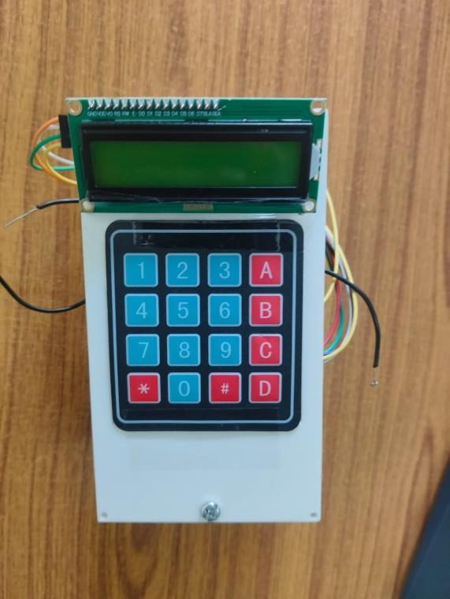
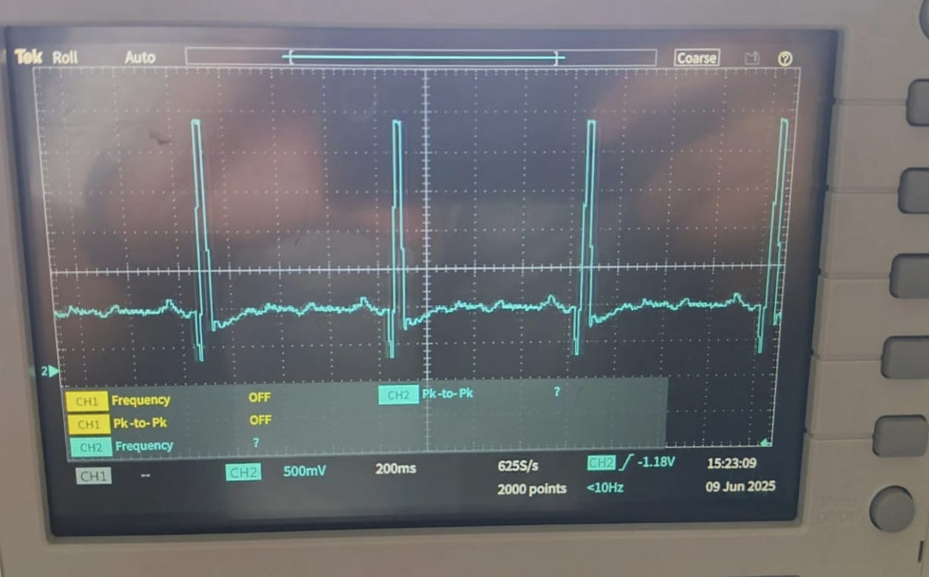
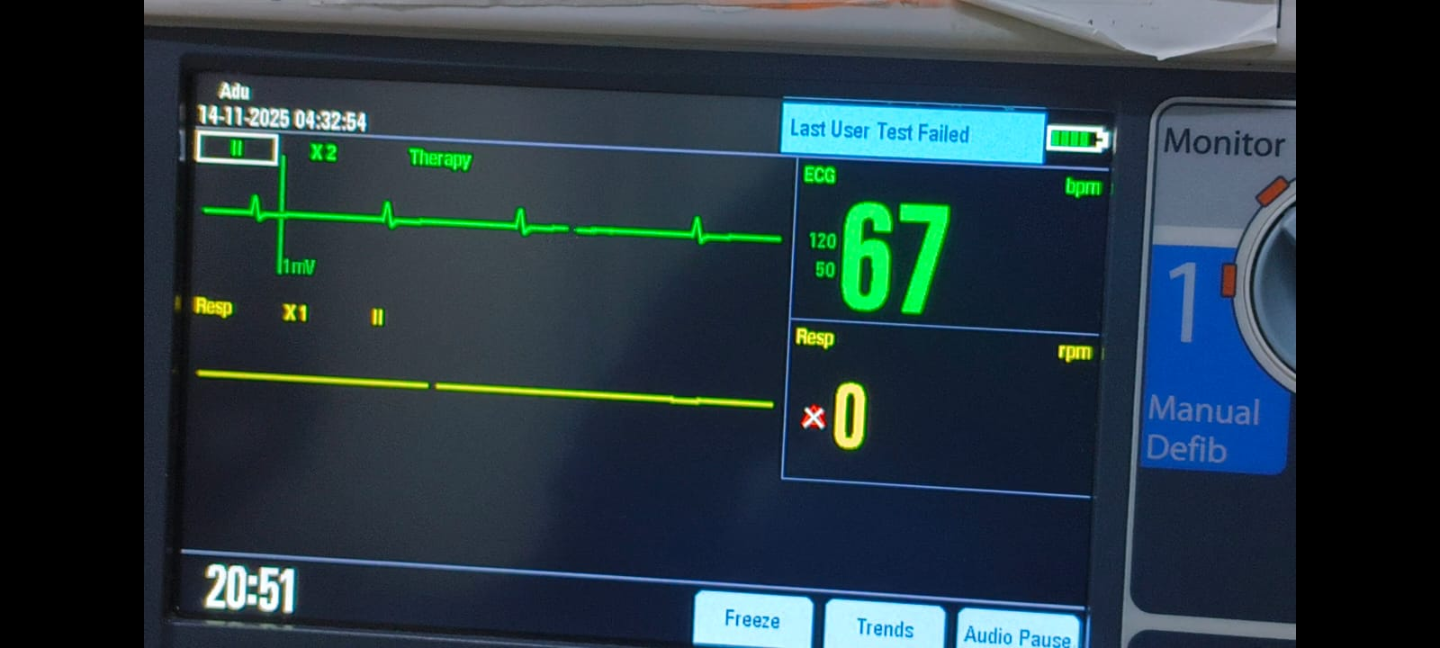
Objectives of the Project:
To design a low-cost portable ECG simulator
Generate normal and abnormal ECG signals
Enable app-based real-time rhythm control
To create an affordable alternative to expensive clinical ECG training
THE LINK TO THE PROJECT :ECGVIDEOLINK
final product photo
Deliverables
Working prototype
Conference paper
App based real time rhythm generator
Open source the project so a community can contribute
output waveform on an oscilloscope
Output waveform on an ecg monitor

