Slide 1


RN SHETTY TRUST®
RNS INSTITUTE OF TECHNOLOGY
UNDERGRADUATE RESEARCH FORUM
URF Round II Project
(August 2025 – April 2026}
Next-Gen Agritech - AI Driven Harvesting
Team Members:
Harsha GM – 1RN22IS047 (VIII sem)
Jenu J Hegde – 1RN22IS057(VIII sem)
Benak Deepak – 1RN22IS024 (VIII sem)
Vikas K S– 1RN23ME053(VI sem)
Yashvardhan C - 1RN23IS250(VI sem)
Yasaswi Nikhil DV - 1RN23EC051(VI sem)
Name of the Supervisor : Dr.Suresh L (HoD and Professor Dept of ISE)
        Divyashree S (Asst Prof Dept of ISE)

Slide 2
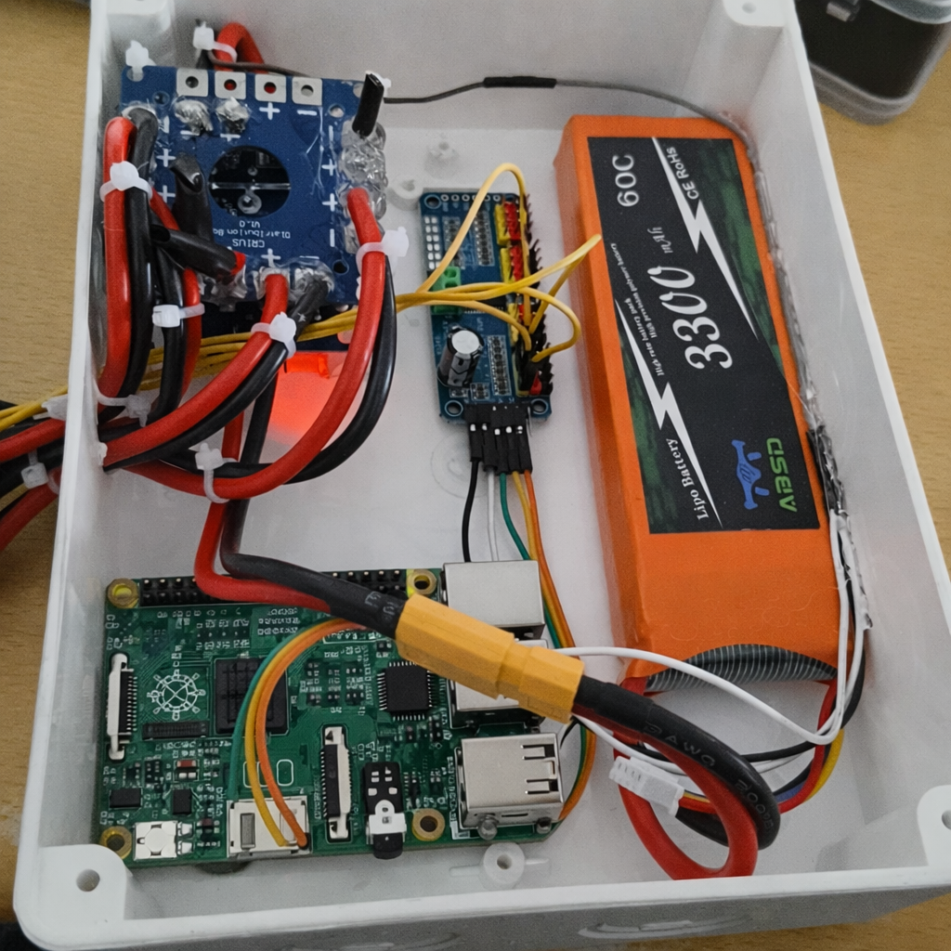
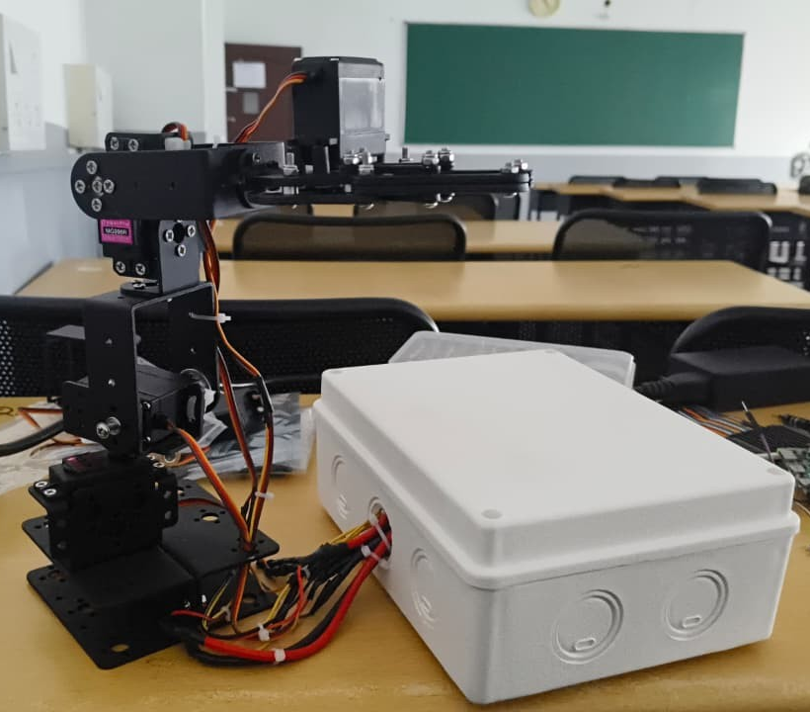
Objectives of the Project:
Develop a 4DOF Robotic Arm for Harvesting
Integrate Raspberry Pi for Vision-Based Intelligence
Enable Decision-Making System
Implement real-time object detection and classification
Deliverables
Controlled 4DOF robotic arm by Raspberry Pi
Integrated Software System for Detection and Control
User-Guided Robotic Harvesting System for Tomatoes
Video link : NextGen-AgriTech-Demonstration-video

