Slide 1


R N SHETTY TRUST
RNS INSTITUTE OF TECHNOLOGY
Undergraduate Research Forum
URF ROUND II Project
(August 2025 – April 2026)
Microstructural and Mechanical Behaviour of Al2014 Reinforced with FeCuMnNiCr High Entropy Alloy Particulates for Aerospace Application
Guide Names of Team Members
Dr. Bharath V Mithun MS -1RN23ME028
Associate Professor Vijay S -1RN23ME050
Dept. of Mechanical Engineering P R Shree -1RN21ME018
B K Sujal Jain -1RN21ME005
Raghavendra C Patil -1RN21ME021
Dept. of Mechanical Engineering, RNSIT

Slide 2
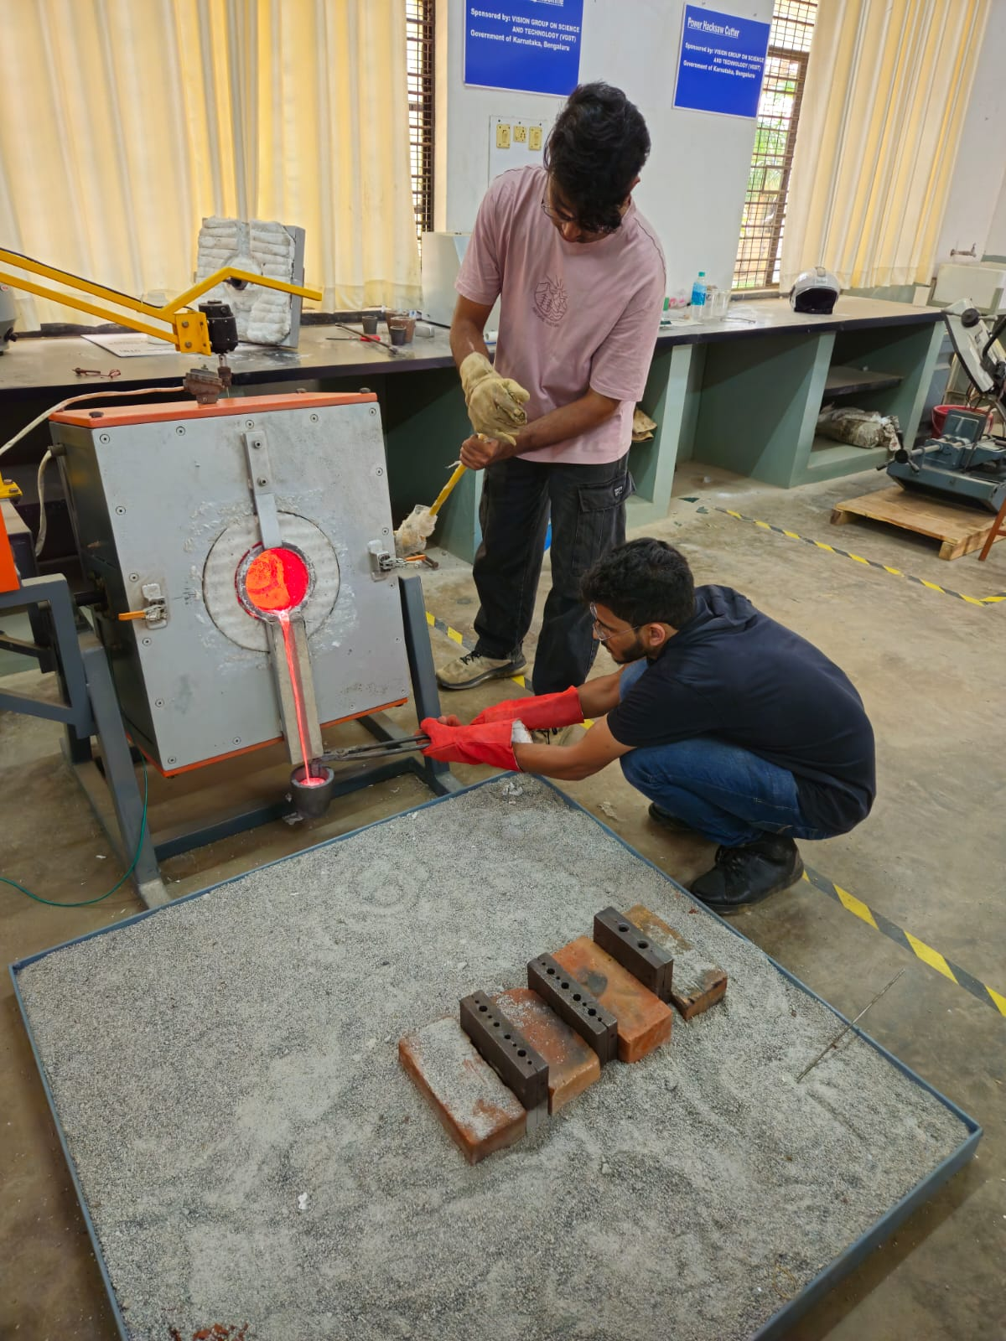
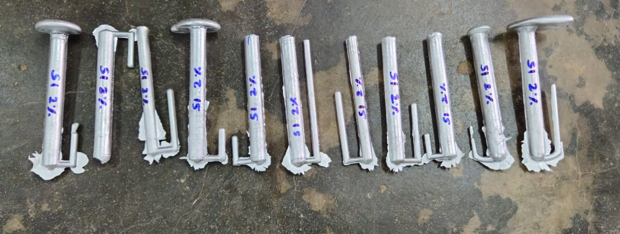
Objectives of the Project
  Synthesis: Prepared Al2014–HEA composites with 2, 4, and 6 wt.% HEA using ball milling with varied milling durations.
  Characterization: Analyzed microstructure and composition using XRD, SEM, and EDS techniques.
  Mechanical Evaluation: Tested hardness, tensile, and compression properties (ASTM standards) and compared Al2014 vs. HEA-reinforced composites.
Deliverables
  Strength Results: 4-hour sample achieved highest tensile (152 MPa), yield (134 MPa), and compressive strength (532 MPa).
  Hardness Trend: Hardness increased significantly, peaking at ~113 HV for the 4-hour sample due to grain refinement.
  Microstructural Insight: XRD shows strong FCC and BCC phases in 4-hour sample, indicating better alloying and structure.
Video Link: https://drive.google.com/file/d/1b_FVJJYklc79QJSr6Xos25v0VHewcdZP/view?usp=drivesdk

