Slide 1


R N SHETTY TRUST
RNS INSTITUTE OF TECHNOLOGY
  URF Round-II Mid-Term Review
  Stand Support and Stability Devices for Mobility Assistance
Guide: Dr. Sreevidya R C
Associate Professor - Dept of CSE(Data Science)
Co-Guide: Sunil B Lakkundi
Assistant Professor - Dept of Mechanical
{Names of Team Members}
H C Ganavi (1RN23CD039) Vikas K S(1RN23ME053)
M Kruthika (1RN23CD055) Gowtham Kumar K(1RN23ME015)
Supritha Reddy(1RN23CD046) Krishna K(1RN23ME023)
M S Nithyasree (1RN23CD054)
  {Date}

Slide 2

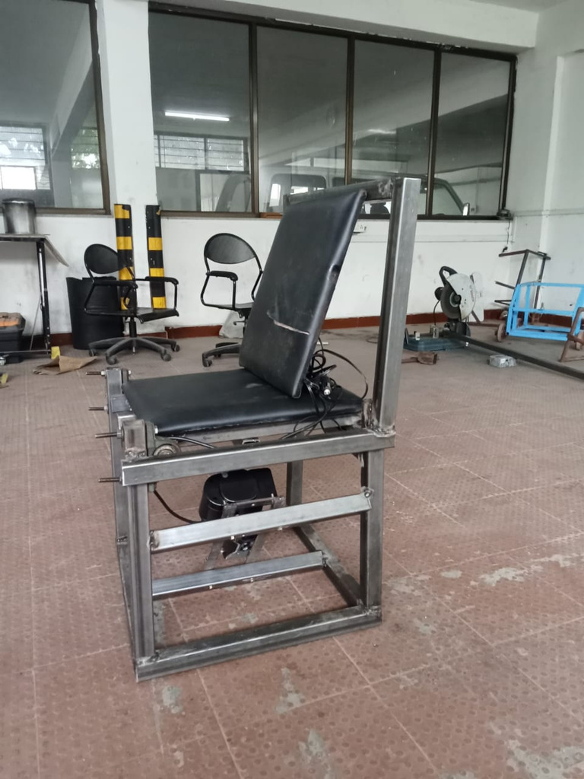
Objectives
  Design a motorized sit-to-stand assist system.
  Integrate scissor jack mechanism for lifting support.
  Implement wireless control using ESP32.
  Develop web-based interface with voice control.
  Ensure safe and stable motor operation.

Slide 3
Results & Discussion
Results:
  Successful development of Arduino-based motor control prototype
  Smooth implementation of UP, DOWN, and STOP operations
  Successful integration of ESP32 for wireless control
Discussion:
  The transition from Arduino (wired control) to ESP32 (wireless control) significantly improved system flexibility
  Web-based control eliminated the need for physical switches
  Voice integration enhanced user convenience and accessibility

