Slide 1

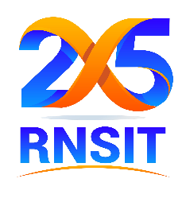
R N SHETTY TRUST
RNS INSTITUTE OF TECHNOLOGY
URF Round-II Mid-Term Review
OSTEODETECT AR
Guide: Dr Harsha S DIKSHA (1RN22AD013)
Co-Guide :Dr Sreevidya R C SHRUTHI N (1RN22AD046)
SHWETHA M (1RN22AD047)
16/2/2026

Slide 2
Objectives
Detecting bone fractures from X-ray images using deep learning.
To precisely segment bone regions for clearer visualization.
Reconstruction of a 3D bone model from a single 2D X-ray image.
Reducing diagnostic errors caused by manual interpretation.

Slide 3

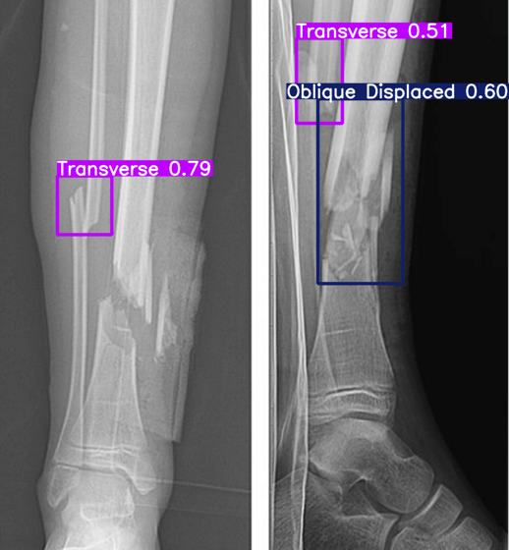
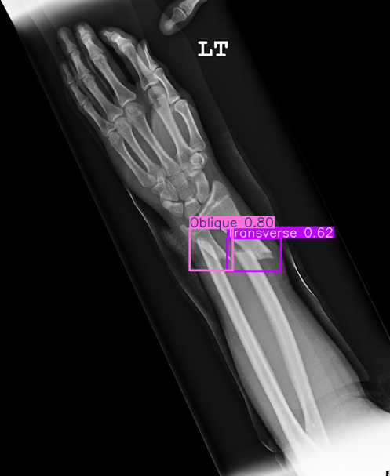
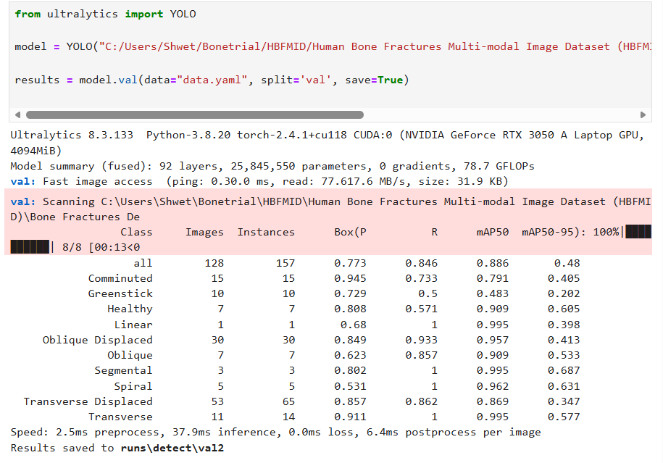
Results & Discussion

Slide 4
Deliverables
Optimized fracture detection model (YOLOv8 fine-tuned for medical X-ray dataset)
Improved 3D reconstruction (single X-ray to 3D mesh)
Research paper on bone fracture detection and 3D reconstruction.
Fully functional AR prototype.
Integrated end-to-end working system (Fracture Detection + 3D Reconstruction + AR Integration).
Performance evaluation report.

