Slide 1


RN SHETTY TRUST®
RNS INSTITUTE OF TECHNOLOGY
UNDERGRADUATE RESEARCH FORUM
URF Round II Project
(August 2025 – April 2026}
DDoS Detection and Mitigation
Team Members:
Information Science and Engineering
Nischay Sai D R
Poorvi Patel
Varshini Maddula
Bhavana V
Name of the Supervisor: Janardhan Singh

Slide 2
Objectives of the Project:
Detect DDoS attacks in real-time using traffic pattern analysis
Implement AI-based anomaly detection for identifying suspicious behavior
Design a progressive mitigation system (rate limit → challenge → block)
Visualize live network traffic and attack status using a dashboard
Improve system reliability by reducing false positives using adaptive learning.
Deliverables
Working prototype of DDoS Detection & Mitigation System
AI model for anomaly classification (basic ML implementation)
Real-time monitoring dashboard (traffic + alerts + blocked IPs)
Implementation of automated mitigation techniques (rate limiting, blocking)
Project Video.

Slide 3
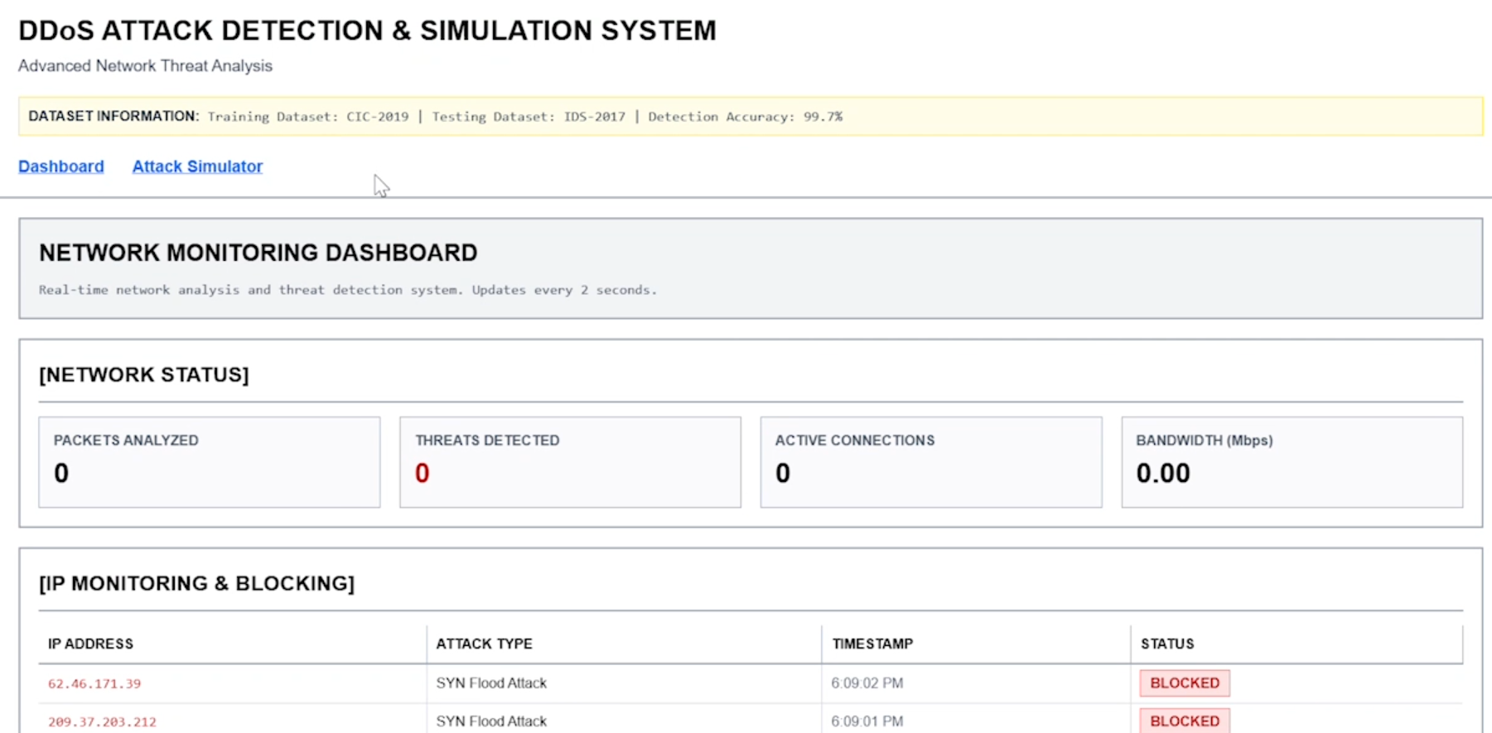
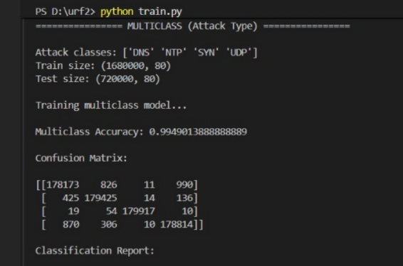
Project images
Frontend – Attack Detection
Trained ML – model working
Video link :https://drive.google.com/file/d/1PnKj2r80ck6PbPUzlPPXckwkaKi00Cwq/view?usp=sharing

