Slide 1


RN SHETTY TRUST®
RNS INSTITUTE OF TECHNOLOGY
UNDERGRADUATE RESEARCH FORUM
URF Round II Project
(August 2025 – April 2026}
SMARTLOCK AUTHENTICATION SYSTEM USING BLE PROXIMITY AND CRYPTOGRAPHICALLY - SIGNED VP TRANSPORT
Team Members:
Chethana R 1RN23CY012 CSE-CY
Darshan N 1RN23CY013 CSE-CY
Rithika Shetty 1RN23CY043 CSE-CY
Sanjay N 1RN23CY049 CSE-CY
Name of the Supervisor : Dr.Kiran P

Slide 2
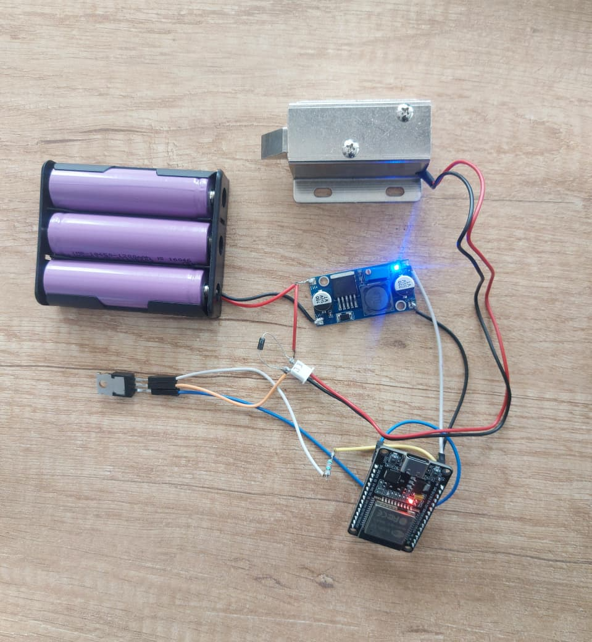
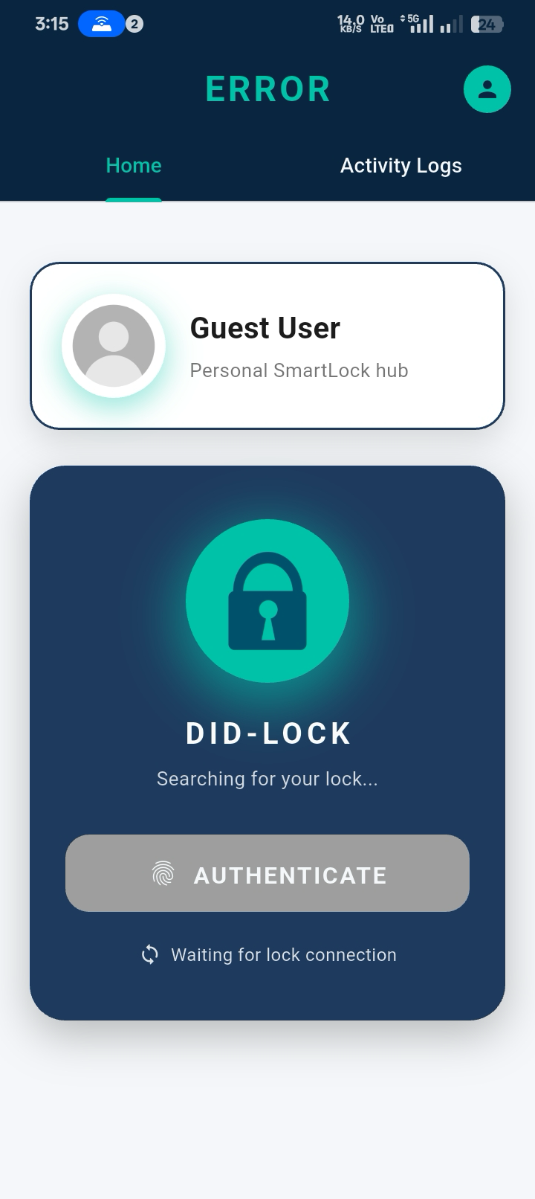
Objectives of the Project:
Build serverless secure smart lock
Implement DID-based authentication
Prevent replay attacks using nonce
Ensure low-cost IoT deployment
Deliverables
Offline Smart Lock System
Lightweight Cryptographic Authentication (Ed25519)
Real-Time Secure Access (~18 ms latency)
Replay Attack Protection (Nonce-based)
Performance & Security Analysis
Project Video :
https://drive.google.com/file/d/1Hzr9XjiNEXXP2T18572i0-xkT31urTZz/view?usp=sharing

