Slide 1


RN SHETTY TRUST®
RNS INSTITUTE OF TECHNOLOGY
UNDERGRADUATE RESEARCH FORUM
URF Round II Project
(August 2025 – April 2026}
Structural Health Monitoring: Identifying
Cracks In Concrete Using Iot SenSor
Team Members:
CIVIL BRANCH and 6th Semester Students
Names
VIVEK L
VIKAS C
KEERTHANA C
THOSHITHA C
Name of the Supervisor: ARJUN P

Slide 2
Objectives of the Project:
Design and implement a sensing mechanism using smart aggregates embedded within concrete
Monitor internal stress variations and identify early-stage structural damage
Enhance safety and reliability of structures, especially in earthquake-prone regions
Contribute to preventive maintenance and reduce the risk of sudden structural failure
Deliverables
Concrete specimen with embedded smart aggregate
Functional crack detection system
Arduino and ESP32 hardware setup
Real-time alert system (Blynk app)
Compression testing results
Data analysis and graphs
Project report/documentation
Presentation and working demonstration

Slide 3
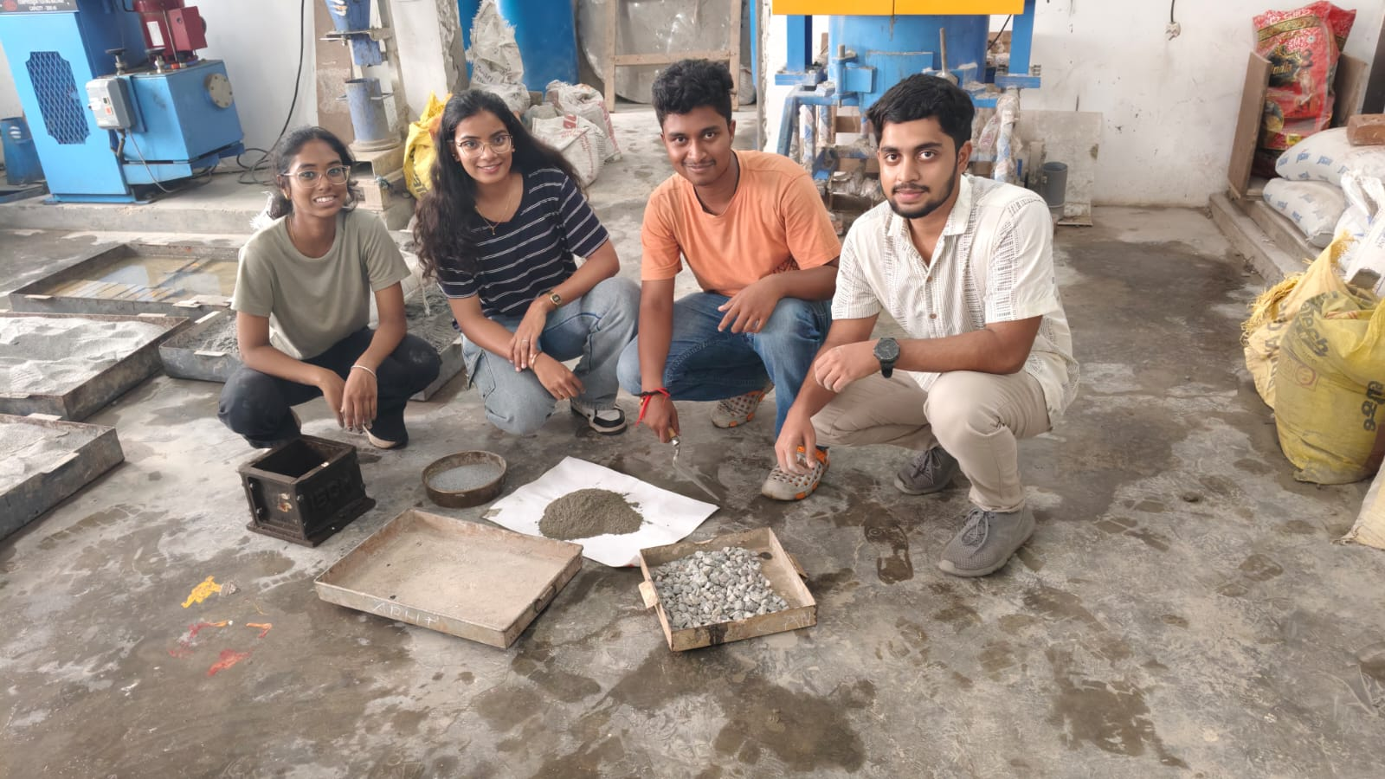
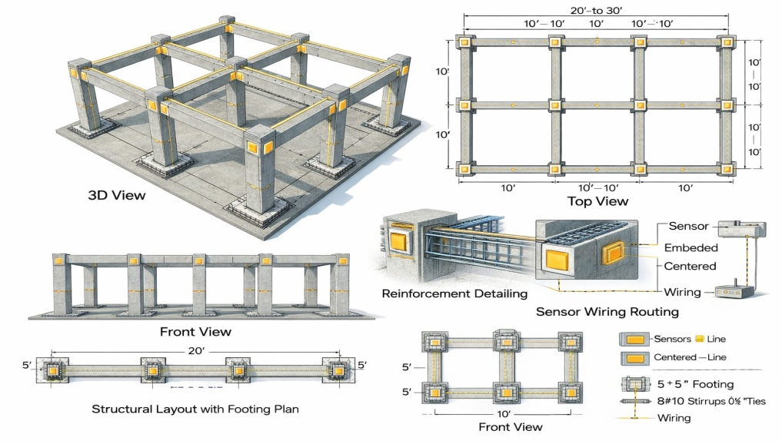
BEGINNING OF THE PROJECT
FINAL OUTCOME
CHECK OUT THE LINK FOR VIDEO
https://canva.link/c5xn9bavyrqc9pg

