Slide 1


RN SHETTY TRUST®
RNS INSTITUTE OF TECHNOLOGY
UNDERGRADUATE RESEARCH FORUM
URF Round II Project
(August 2025 – April 2026}
Synthesis, Characterization and Super Capacitor Performance Study of Ferrite Based Carbon Composite Derived from Organic Source
Team Members:
Sai Siddarth B, CS-AIML, 4th Sem
Trisha M, CSE, 4th Sem
Bhavika Chandar, CS-CY, 4th Sem
Anagha Pramod Vasishta, CSE, 4th Sem
Name of the Supervisor: Dr. SMITHA M G, Assistant Professor, Department of Physics

Slide 2
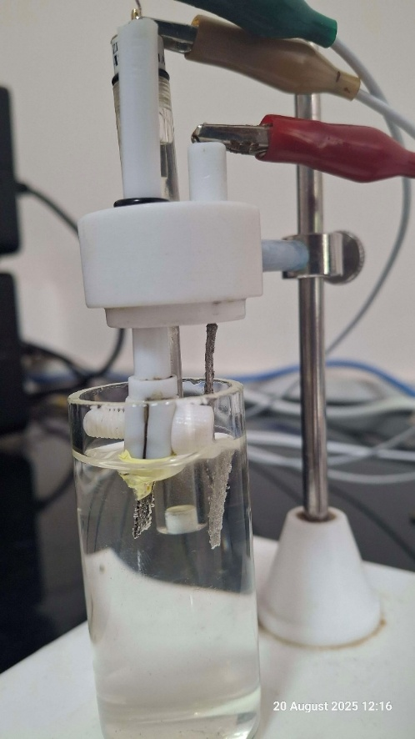
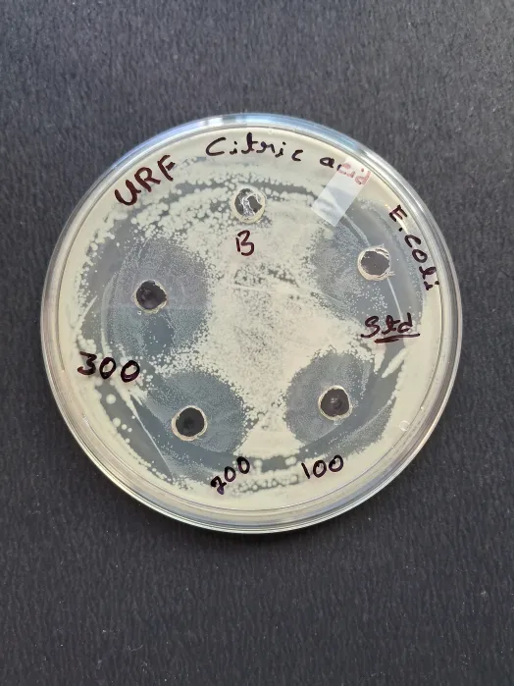
Objectives of the Project:
Synthesis of Compound – Ni_{0.6}Co_{0.3}Fe₂O_{40.1}
Characterization studies
Supercapacitor applications
Anti Bacterial applications
Rhodamine-B dye degradation analysis
Deliverables
Conference Presentations
Paper Publications
Patent Publication / Grant
Cyclic Voltammetry
Antibacterial activity against E.coli
Video Link: https://tinyurl.com/bdeu6ts3

