Slide 1


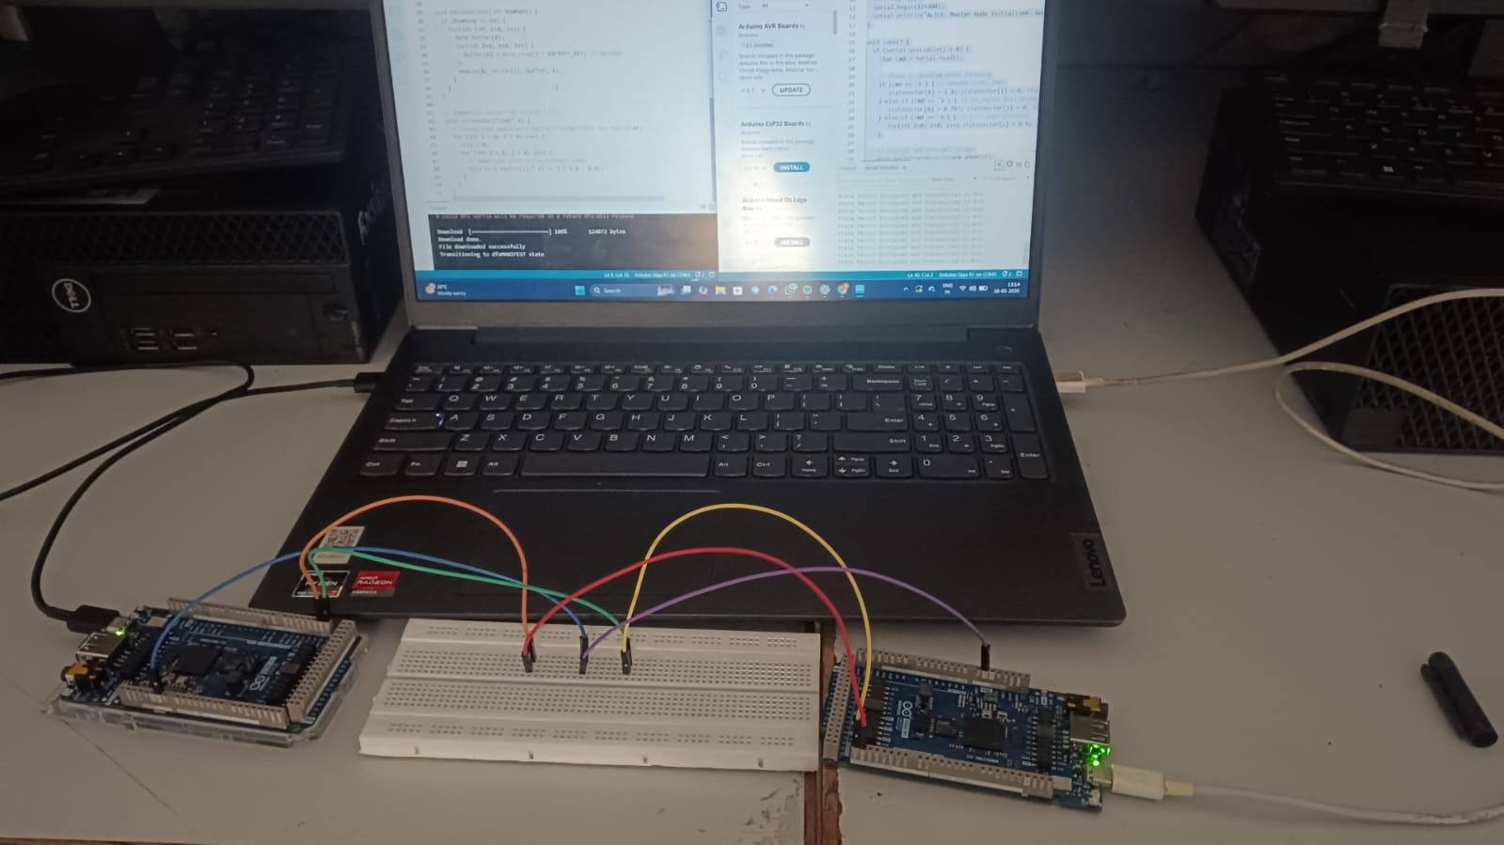
RN SHETTY TRUST®
RNS INSTITUTE OF TECHNOLOGY
UNDERGRADUATE RESEARCH FORUM
URF Round II Project
(August 2025 – April 2026}
Development of a Quantum Key Distribution System
Team Members: 6th sem ECE
Sanjana K Bhat
Shalini V
Name of the Supervisors:
Uma S V (Professor, ECE)
Manjula V K (Professor,ECE)
Hardware Implementation – BB84&E91 Protocol

Slide 2
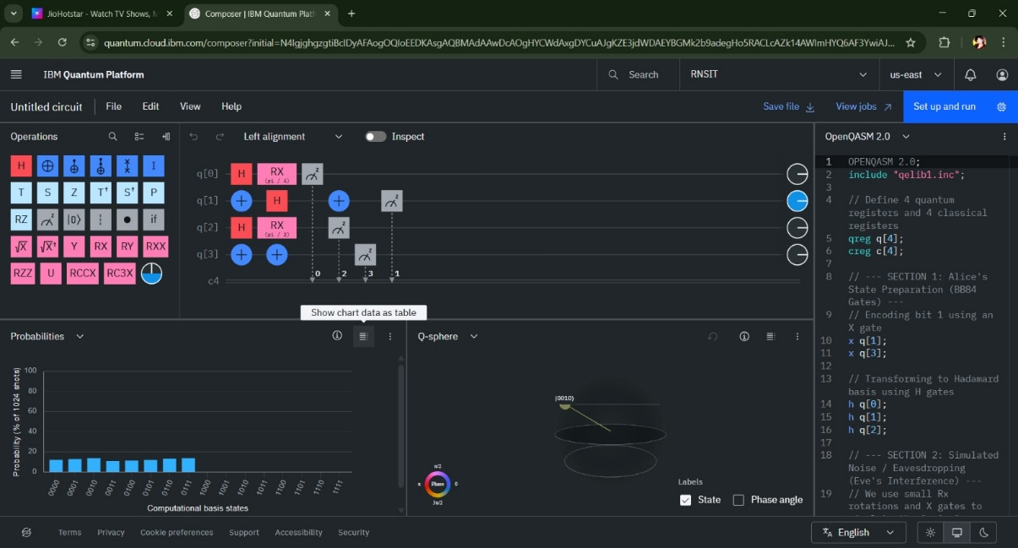
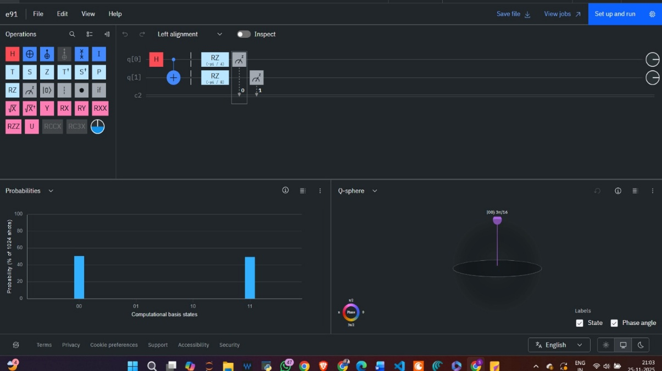
Gate Implementation – BB84&E91 Protocol
Objectives of the Project:
To design a secure communication system using Quantum Key Distribution (QKD).
To implement and analyze BB84 and E91 protocols.
To ensure secure key exchange using quantum principles.
To detect eavesdropping using Quantum Bit Error Rate (QBER).
To simulate and validate the system using Qiskit.
Deliverables
Implementation of BB84 and E91 QKD protocols using Qiskit.
Simulation results showing secure key generation.
QBER analysis for eavesdropping detection.
Comparative study of BB84 vs E91 performance.
Final report/documentation with system design and results
Video link:
https://drive.google.com/file/d/1UDu0KKz3_q_TYugX0zleDi0H-EKcQYSC/view?usp=drivesdk

