Slide 1


RN SHETTY TRUST®
RNS INSTITUTE OF TECHNOLOGY
UNDERGRADUATE RESEARCH FORUM
URF Round II Project
(August 2025 – April 2026}
SWASTHYA: A Diagnosis aid for early disease detection and prevention
Team Members:
1) Raghoothama Rao K S (ECE , 8th sem) 5) Juhi Kothari (AIML, 8th sem)
2) Kuldeep Prasad G C (ECE , 8th sem) 6) Harshitha D Pai ( AIML , 8th sem)
3) N Vijay (ECE , 8th sem) 7) Lakshmi Lavanya ( AIML ,8th sem)
4) Prajwal M ( ECE , 8th sem) 8) H.Leyasri (AIML, 8th sem)
Name of the Guide : Dr. Ibrar Jahan M A
Name of the Co-Guide : Dr. Narendra Kumar

Slide 2
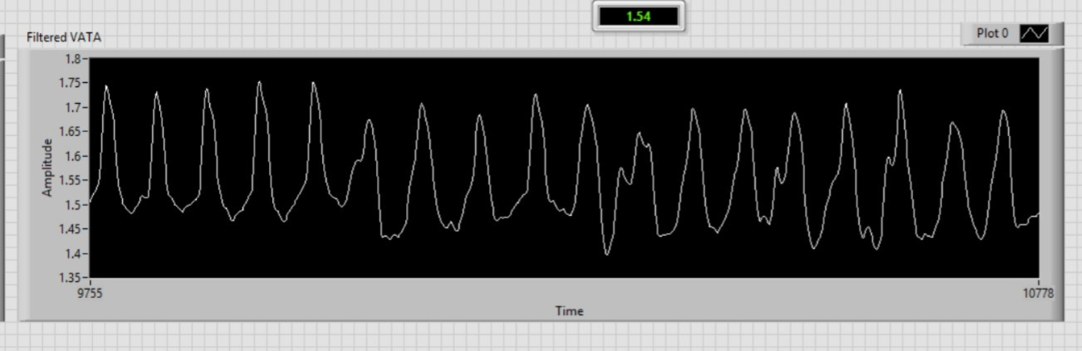
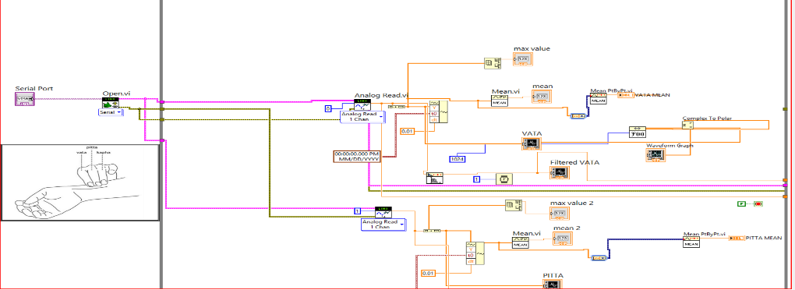
Objectives of the Project:
To get physiological signals from the human body.
To conduct statistical analysis and implement machine learning algorithms.
To display and store the results in cloud.
To develop a user interface for the patient’s interaction with the doctor.
- prominent pictures of the project
Deliverables:
Physiological Signal Acquisition System
Data Analytics and Machine Learning Module
Cloud-Based Data Storage and Display
Patient-Doctor Interaction Interface
- Project Video Link : https://drive.google.com/file/d/1J0plCCNUJwXHjsgowzXd5ulvQkLfHevi/view?usp=sharing

Slide 3
https://drive.google.com/file/d/1J0plCCNUJwXHjsgowzXd5ulvQkLfHevi/view?usp=sharing

