Slide 1


RN SHETTY TRUST®
RNS INSTITUTE OF TECHNOLOGY
UNDERGRADUATE RESEARCH FORUM
URF Round II Project
(August 2025 – April 2026}
DESIGN OF A SMART WEARABLE TEXTILE
FOR VISUALLY IMPAIRED PEOPLE
Team Members:
Electronics and Communication Engineering
IV Semester
Adith D H
Chandan Reddy H C
Hemanth G P
Neha S
Name of the Supervisor:
Dr. Ibrar Jahan M A (Guide)
Dr. Rajini Honnungar (Co- guide)

Slide 2
Objectives of the Project:
Design of a wearable jacket
Design of a wearable shoe
A complete module to assist the visually impaired people
Deliverables:
A wearable prototype
Patent filing
Conference paper

Slide 3
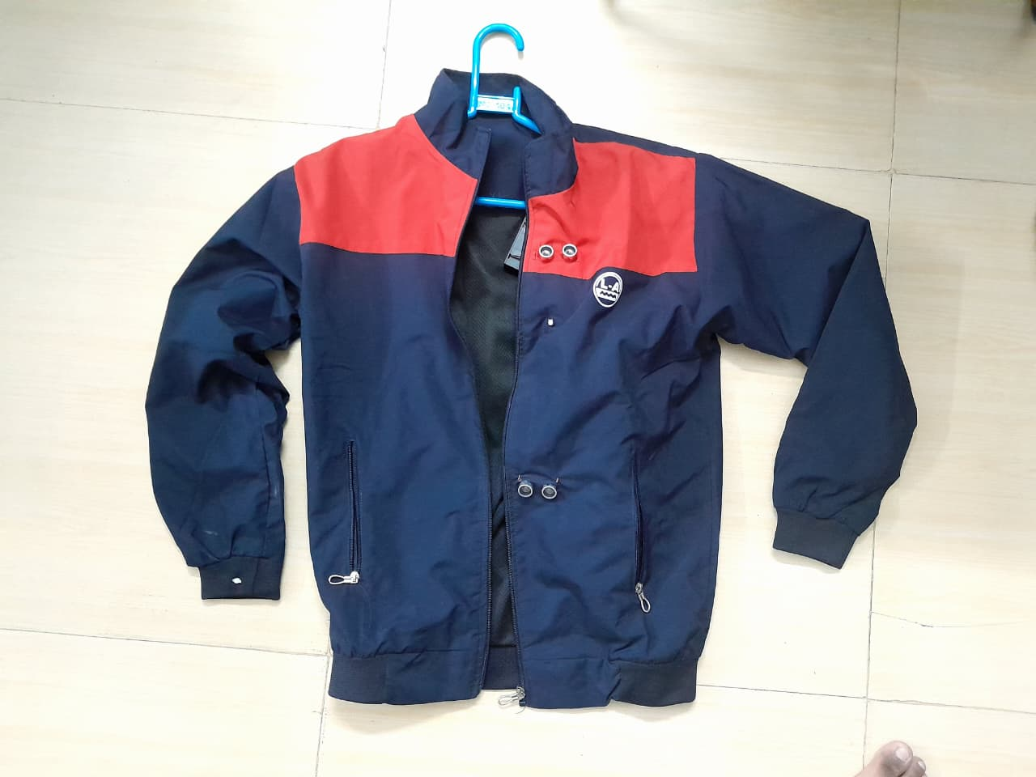
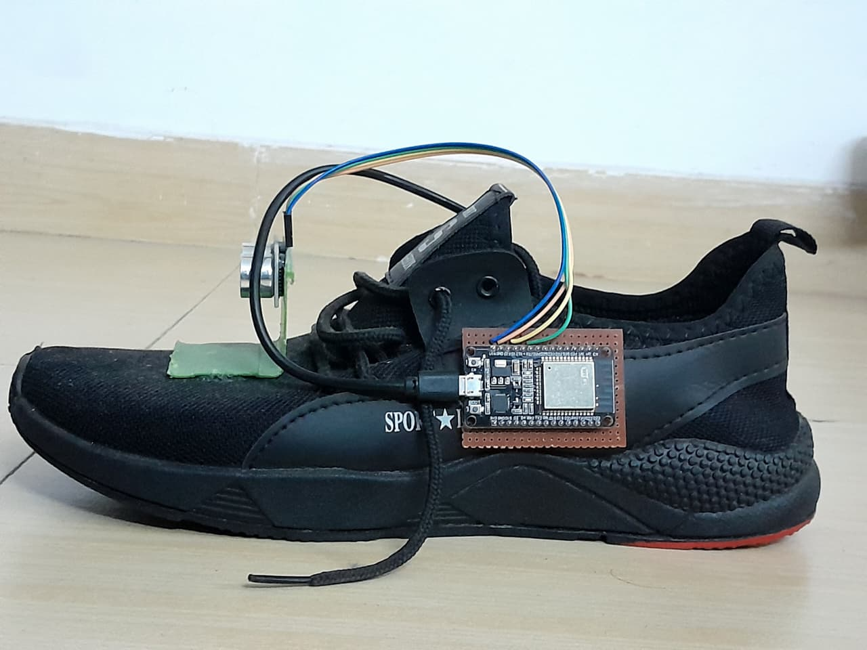
Pictures of the project:
Fig. 1: Jacket module
Fig. 2: Shoe module

Slide 4
Project Video:
https://drive.google.com/file/d/1Bnamdivzidm1FLI1PDRUrBv2wZnD3ZvT/view?usp=drivesdk

