Slide 1


Haptics: Pick and Place Robot
URF Project
Kevin Raymond & Rishika B
Praveven G

Slide 2
Project Overview
Gesture-controlled robotic arm using wearable glove
Uses MPU6050 sensors + ESP32 for motion tracking
Wireless communication via ESP-NOW
Controls servo motors through PCA9685 driver
System translates real-time hand motion into robotic movement, allowing intuitive control for tasks like picking and placing objects.

Slide 3
Working Principle
Glove captures hand motion and input signals
Data processed and sent wirelessly to receiver ESP32
Receiver maps motion data to motor positions
Smooth movement achieved using tuning techniques
Applications: industrial automation, assistive tech, robotics learning

Slide 4
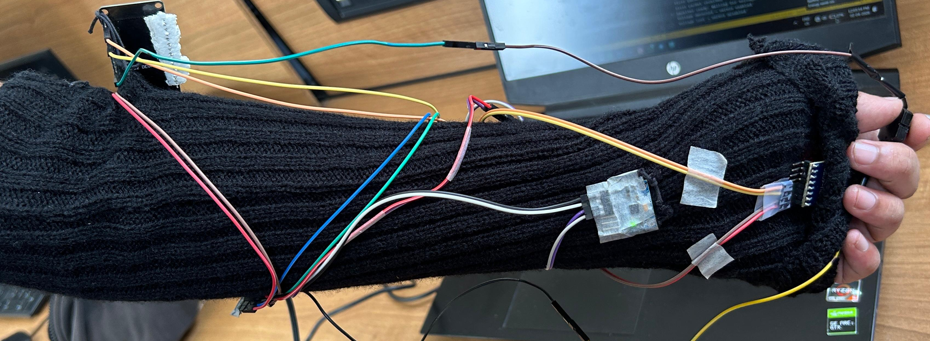
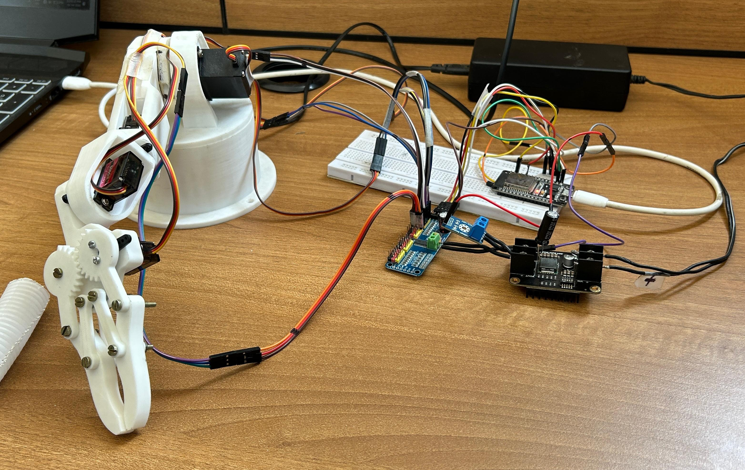
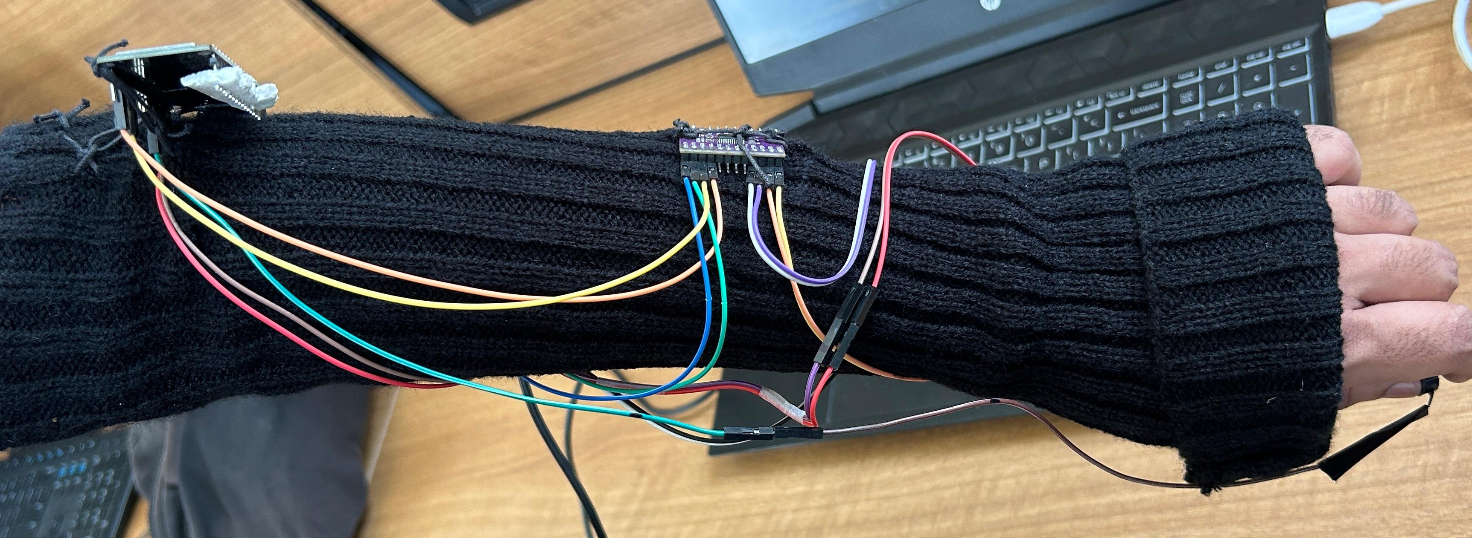
Prototype images
The Glove with sensors
The robotic arm

