Slide 1


RN SHETTY TRUST®
RNS INSTITUTE OF TECHNOLOGY
UNDERGRADUATE RESEARCH FORUM
URF Round II Project
(August 2025 – April 2026}
Powering Street Lights using Bio Gas generated with Household and Agricultural Waste
Team Members: ECE Branch 4th semester
Names:
Sachith B S
Tanmay M S
Varun M A
Vikas D K
Vishnu Kaushik S
Name of the Supervisor: Dr. Yashodha S R

Slide 2
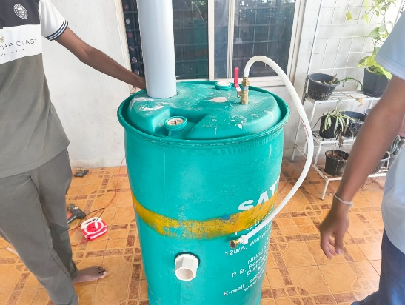
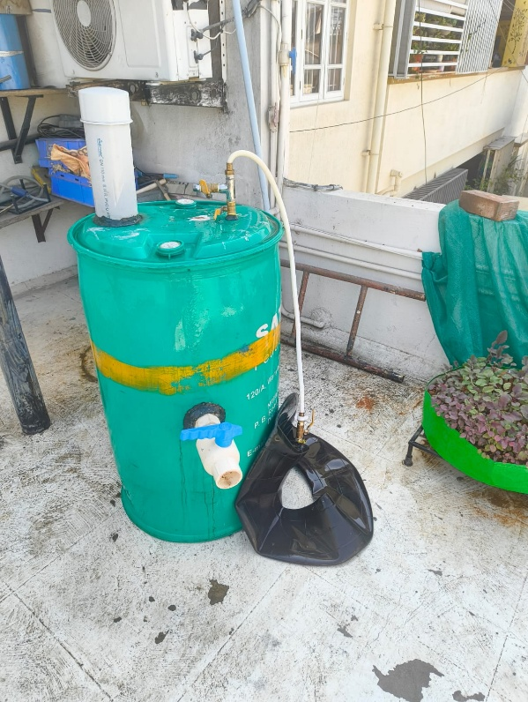
Objectives of the Project:
Design and construct a functional biogas digestion system prototype
Evaluate system efficiency and environmental impact through comprehensive analysis
Disseminate findings through peer-reviewed publication and conference presentation
To apply for a patent
Deliverables
A bio-digester prototype.
The project was presented at an international confereence
Design of the circuitry alongside the bio-digester.
An official patent.
Project Video
Patent Link

Slide 3
