Slide 1


RN SHETTY TRUST®
RNS INSTITUTE OF TECHNOLOGY
UNDERGRADUATE RESEARCH FORUM
URF Round II Project
(August 2025 – April 2026}
{Indoor Navigation using UWB}
Team Members: ECE 6th Semester
{Branch and Semester of Study}
{Names
Keerthana K
Madhuri Ramesh
Namita Lakpoti
Namitha KS
}
Name of the Supervisor: Dr. Manjuprakash, Dr. Uma S V , Dr. Archana Kulkarni

Slide 2
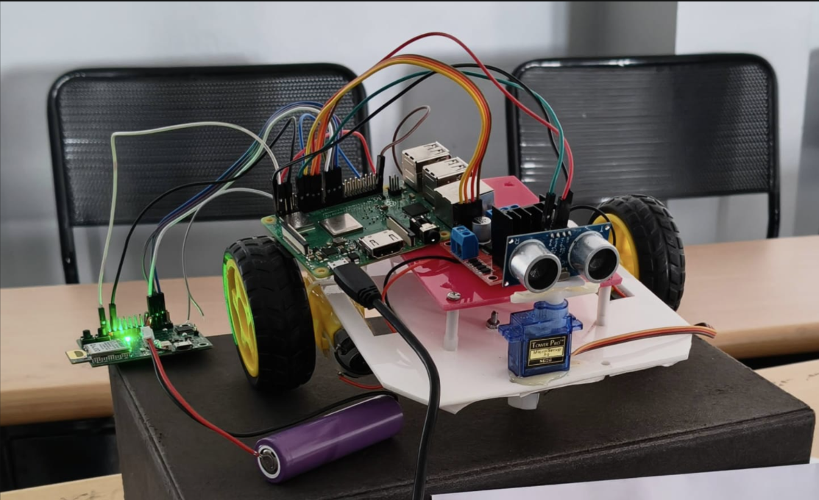
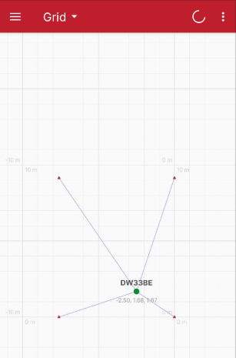
Objectives of the Project:
Develop an Ultra Wide Band(UWB) based Indoor Positioning System to track and guide objects through indoor spaces.
Confirm accomplished tracking through the use of a custom – built enclosure for the tag.
Conduct tests to determine how well the system performs when tracking the location of the object.
Deliverables
Anchor (1 initiator and 3 anchors) – Tag Setup
Utilized the DRTLS application to monitor a UWB network, demonstrating anchor–tag communication
Achieved positioning accuracy of up to 20 cm using this system
Project Video link : https://drive.google.com/drive/folders/1iltV65g25_X3WGvtYB5g7AAV8g4wLJHs

