Slide 1
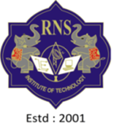
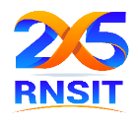
RN SHETTY TRUST®
RNS INSTITUTE OF TECHNOLOGY
UNDERGRADUATE RESEARCH FORUM
URF Round II Project
(August 2025 – April 2026}
Sustainable Treatment of Silk Wastewater using Electrocoagulation method to evade Eutrophication of lakes
Team Members:
Department of Civil Engineering,8th sem.
Names :
Muruli Yadav M (1RN22CV008)
Neha Gowda K (1RN22CV009)
Chethan U (1RN23CV404)
Vivek Soorie (1RN23CV414)
Name of the Supervisor: Mr. Abhilash N R
Assistant Professor
Dept of Civil Engg.

Slide 2
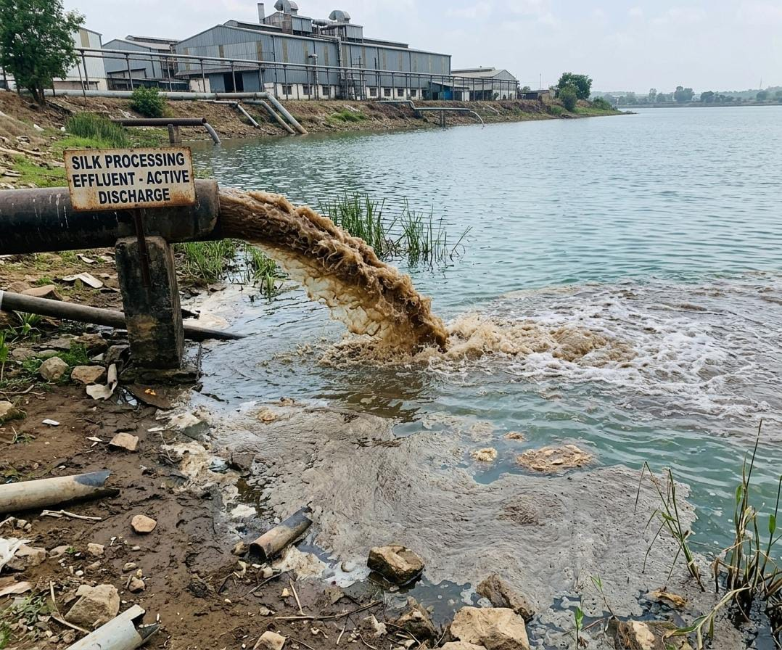
Objectives of the Project:
To treat silk wastewater using electrocoagulation
To prevent eutrophication of lakes
To improve water quality for reuse/discharge
To develop a sustainable treatment method
Deliverables
Effective removal of BOD, COD, TSS, color
Optimized electrocoagulation parameters (voltage, time, electrodes)
Developed lab-scale treatment setup
Improved water quality for reuse
Cost-effective & eco-friendly solution, Scope for industrial scale application

Slide 3
