Slide 1


RN SHETTY TRUST®
RNS INSTITUTE OF TECHNOLOGY
UNDERGRADUATE RESEARCH FORUM
URF Round II Project
(August 2025 – April 2026}
FidoFeed: Integrated Feeding & Monitoring System
Guide
Dr. Rajini V Honnungar
(Professor & HoD)
Co-Guide
Dr. Prabhavathi C N
(Assoc. Prof.)
Team Members: ECE – 8th Sem
Kirthan K M (1RN23EC416)
Mohammed Arfad K (1RN23EC422)
Druva Mahendra Shetty (1RN23EC409)

Slide 2
Objectives of the Project:
To design and develop an IoT-based automated pet feeding system.
To ensure scheduled and portion-controlled food dispensing.
To integrate sensors for real-time monitoring of system parameters.
To prevent unauthorized access to food by multiple pets.
To provide reliable and efficient pet care with minimal human intervention.
Deliverables :
Development of a new IoT-based smart pet care model
Design of an automated and interactive feeding system
Prototype implementation using embedded systems and sensors
Integration of mobile application for remote monitoring and control
Focus on improving efficiency and reliability in pet car

Slide 3
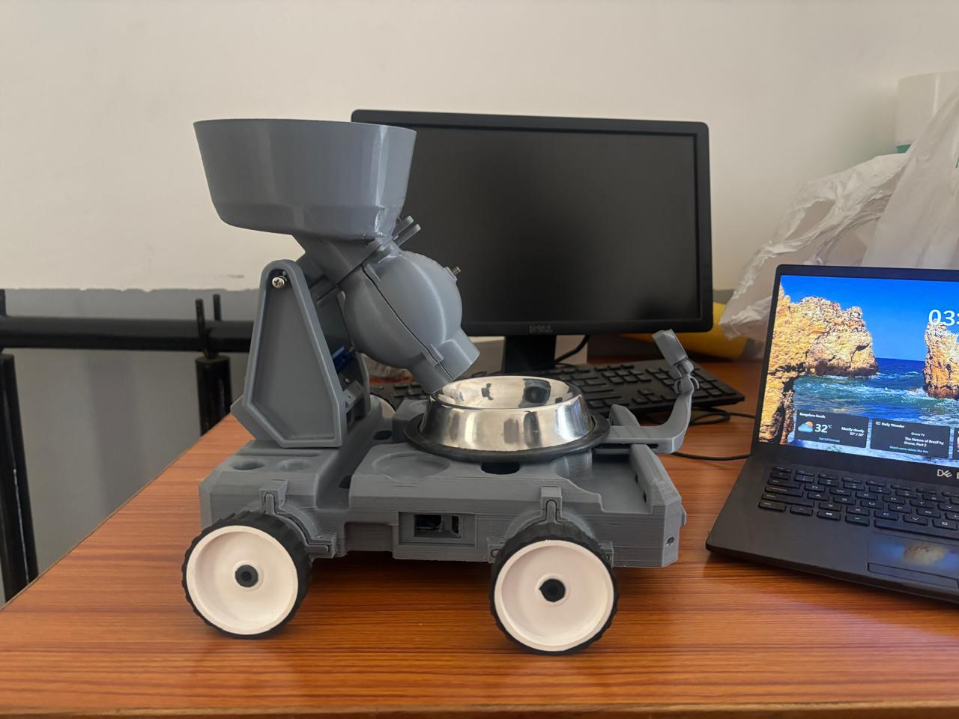
Prototype Model

Slide 4
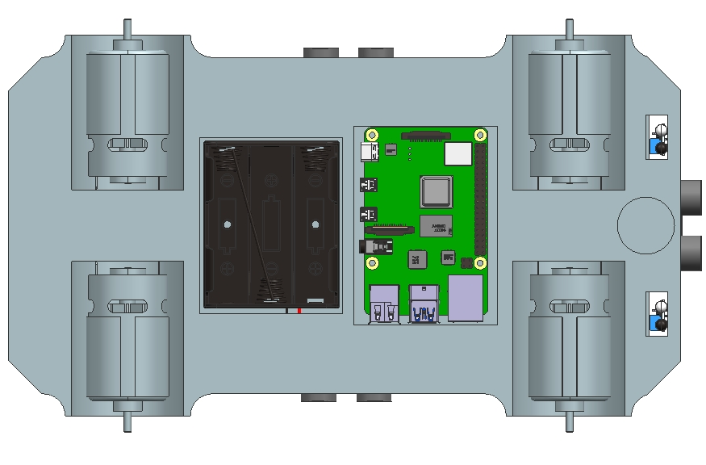
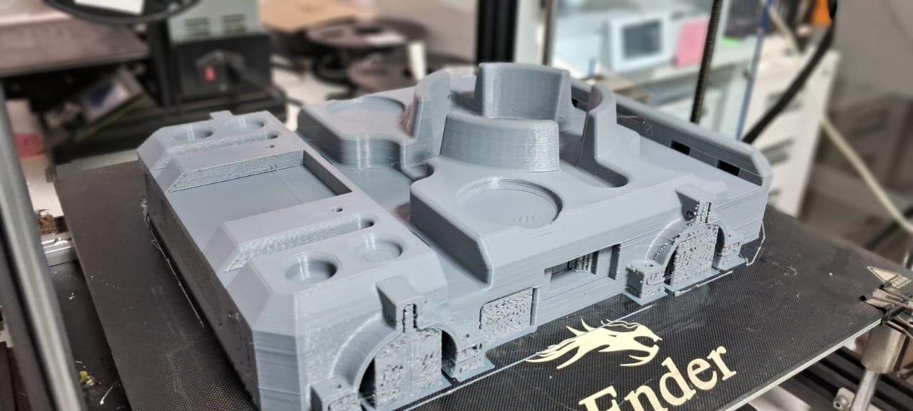
Prototype Design
Figure : Bottom View of the Model
Figure : Printing Process of the Model
Project Implementation (Images and Testing Video) : https://drive.google.com/file/d/1hP0pRa8rpp5Lb_8ib3brCUBQ6Pl7Jg6S/view?usp=drive_link
https://drive.google.com/drive/folders/1dISWBQhpkmMXWXJQ9saoqXWUJIg6pgz2?usp=drive_link

