Slide 1


RN SHETTY TRUST®
RNS INSTITUTE OF TECHNOLOGY
UNDERGRADUATE RESEARCH FORUM
URF Round II Project
(August 2025 – April 2026}
ECOBOT – WASTE SEGREGATOR
Team Members:
Astha Naik ( AI & ML – 6th Sem)
Chaithrashree K P( AI & ML – 6th Sem)
Kriti Raj ( AI & ML – 6th Sem)
Anushree Rao ( AI & ML – 6th Sem)
Guide: Dr Priyanga P, Professor
Dept of CSE (AI & ML)

Slide 2
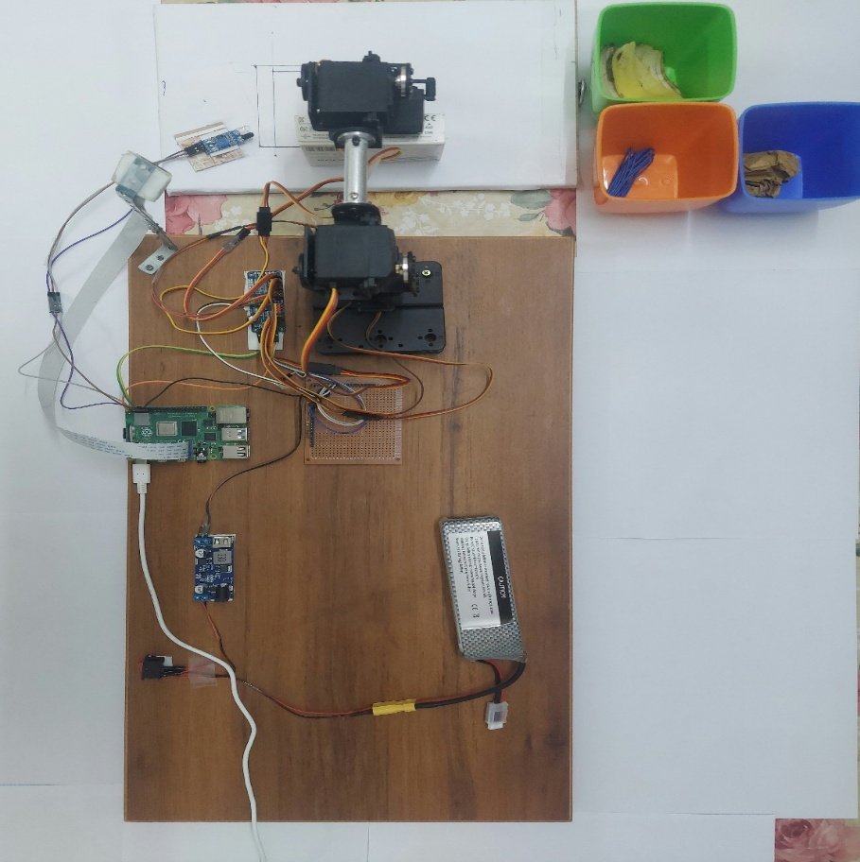
.
Objectives
Design and develop an automated waste-segregation robotic arm.
Accurately detect and classify different types of waste.
Use sensors, image processing, and machine learning for efficient detection.
Reduce manual segregation, improve worker safety, and enhance recycling efficiency for sustainable waste management.
Deliverables
YOLOv8 Nano-based waste classification model (edge-optimized)
Homography-based spatial localisation framework
Planar inverse-kinematics design
Functional AI-powered waste segregation prototype
Real-time deployment on Raspberry Pi
Conference paper and journal publication
Participation in technical competitions / hackathons
Scope for patent exploration
https://files.catbox.moe/qlg3ms.mp4

