Slide 1


RN SHETTY TRUST®
RNS INSTITUTE OF TECHNOLOGY
UNDERGRADUATE RESEARCH FORUM
URF Round II Project
(August 2025 – April 2026}
BATTERY THERMAL MANAGEMENT SYSTEM
Team Members:
Electrical and Electronics Engineering
Vadiraja G prasad (6th semester)
Shreyas Moudgalaya KM (6th semester)
Varun A (6th semester)
Raaj J Radder(4th semester)
Anjali R )4th semester)
Name of the Supervisor: Dr.Sharadha Prasad N

Slide 2
Objectives of the Project:
To design a liquid-based battery cooling system.
To prevent overheating and thermal runaway.
To monitor battery temperature using a temperature sensor.
To improve battery safety, performance, and lifespan.
To implement automatic coolant circulation.
Deliverables:
Functional liquid-cooled battery thermal management prototype
Demonstration-ready working model
Research paper submission (planned)
Patent application filing in progress for the proposed cooling system design

Slide 3
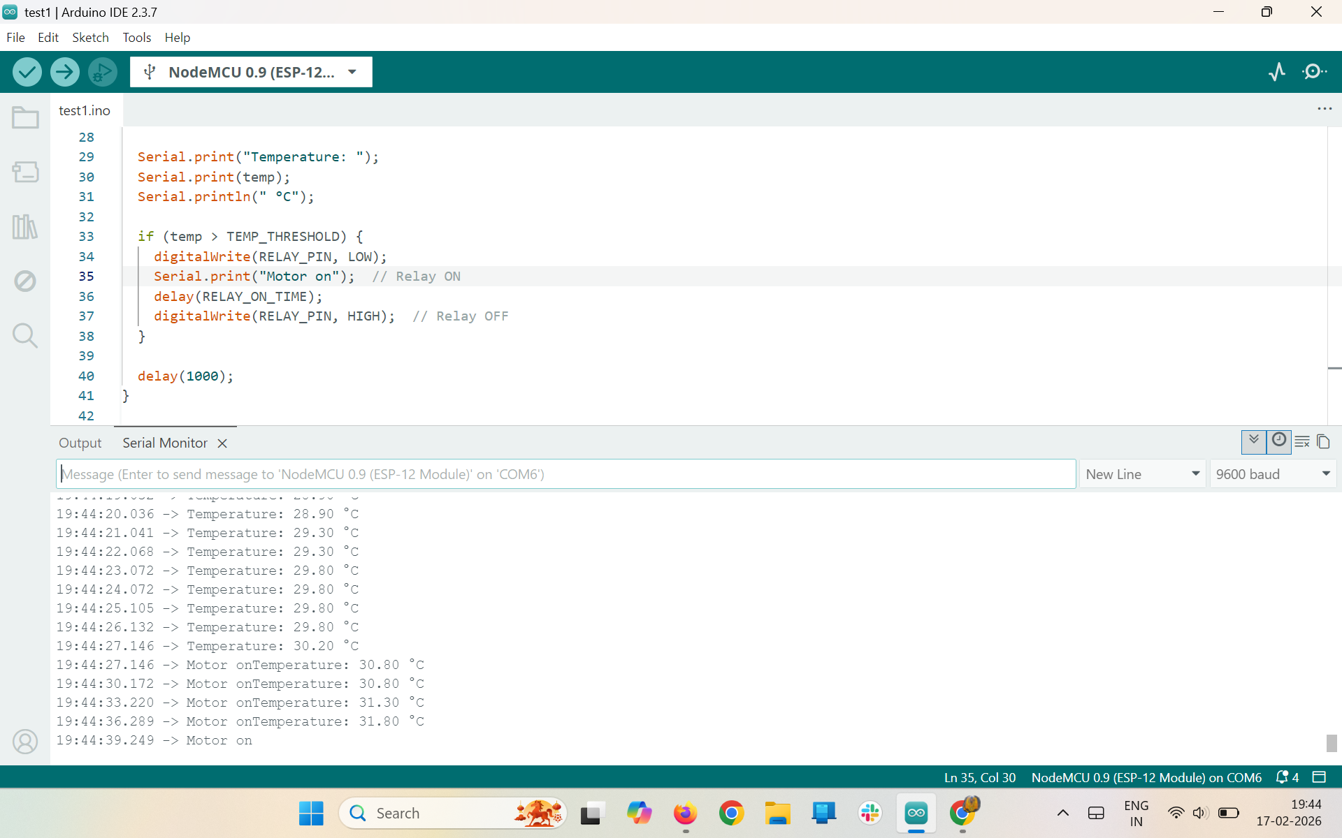
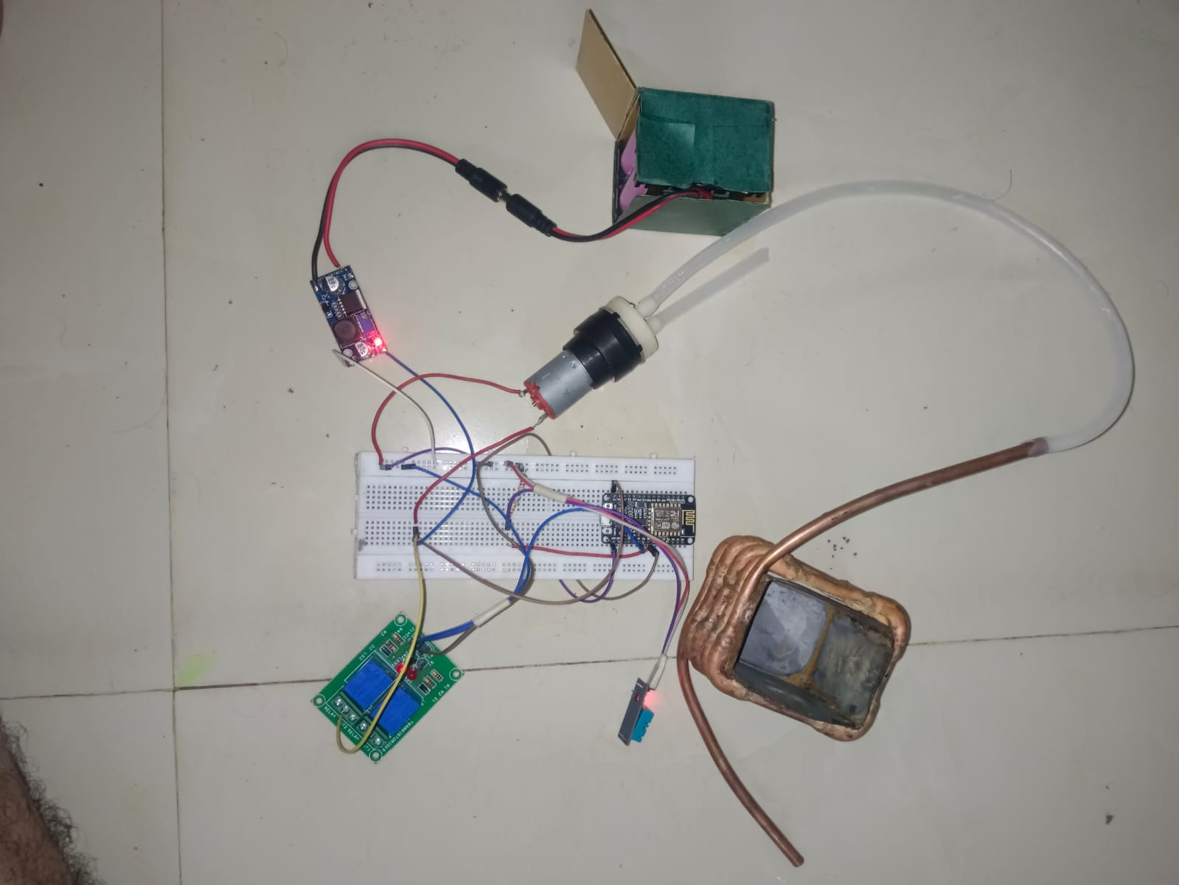
Project Video Link:
https://drive.google.com/file/d/1masR1qfYiAAPboJwsPEgD-iz7jSF_jzM/view

