Slide 1


RN SHETTY TRUST®
RNS INSTITUTE OF TECHNOLOGY
UNDERGRADUATE RESEARCH FORUM
URF Round II Project
(August 2025 – April 2026}
Joystick Controlled 6-axis Laparoscopic robotic arm
Team Members:
Mohit B 8-CSE-B
Rohit DS 8-CSE-C
Snehalatha 8-CSE-C
Vijay Kumar K 8-CSE-C
Vivek Goutam 8-CSE-C
Name of the Supervisor:
Dr. Abhijith H V(HoD CY)
Dr. Suresh (SJRI)

Slide 2
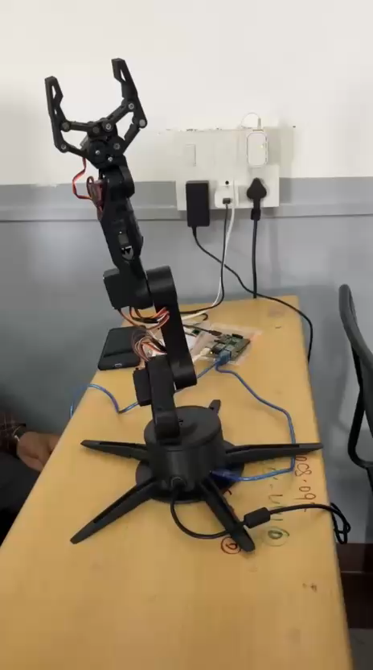
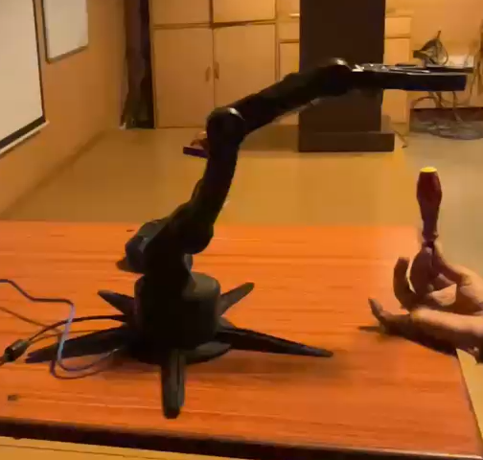
Objectives of the Project:
Build a fully working prototype
Acquire a patent on our design
Apply for AICTE research grant
Build a commercially viable product
Deliverables
A fully working prototype
Design and documentation for the prototype
A design patent
Video Link:
https://drive.google.com/file/d/1ginnzYrO-GsXIqbk5y89hqf_Fpw-V6fU/view?usp=sharing

