Slide 1


RN SHETTY TRUST®
RNS INSTITUTE OF TECHNOLOGY
UNDERGRADUATE RESEARCH FORUM
URF Round II Project
(August 2025 – April 2026}
VARUNA
Team Members:
CSE , 8th Sem
Names
ROHITH DS
VIVEK GOUTAM
VIJAY
MOHITH B
Name of the Supervisor: Dr. Abhijith H V

Slide 2
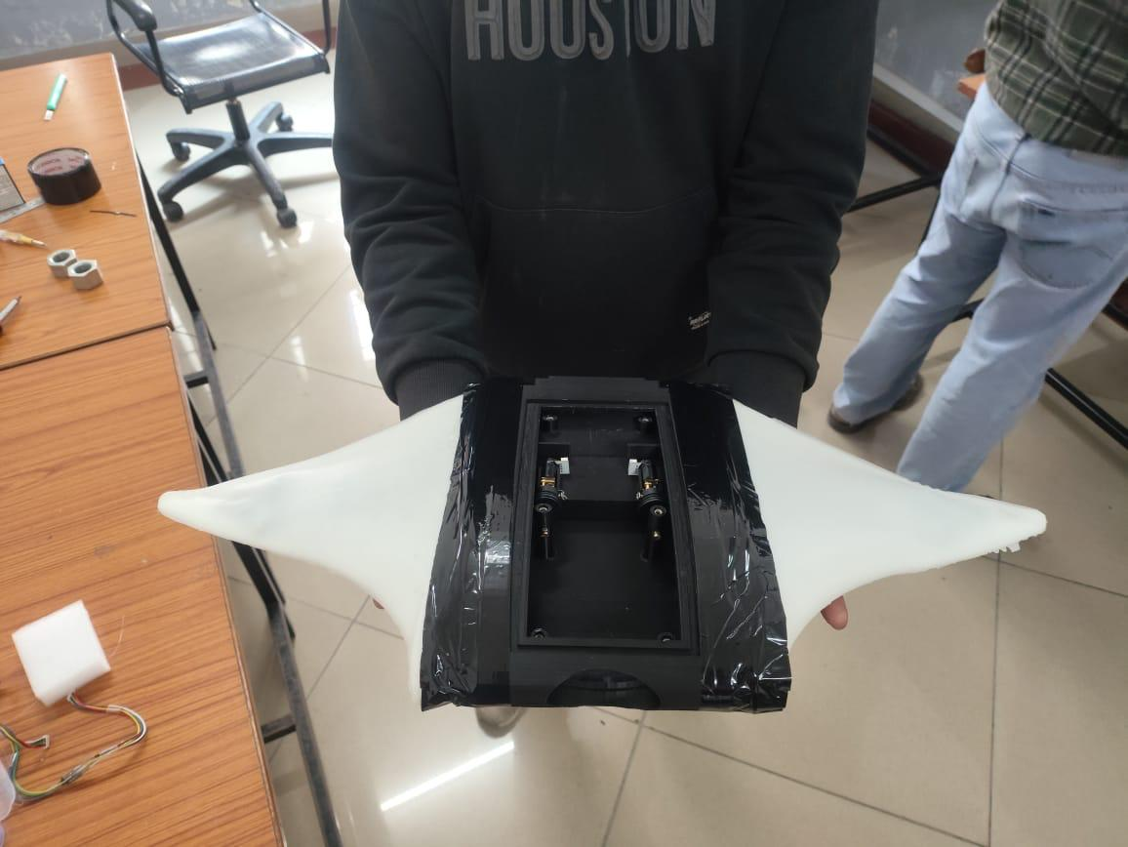
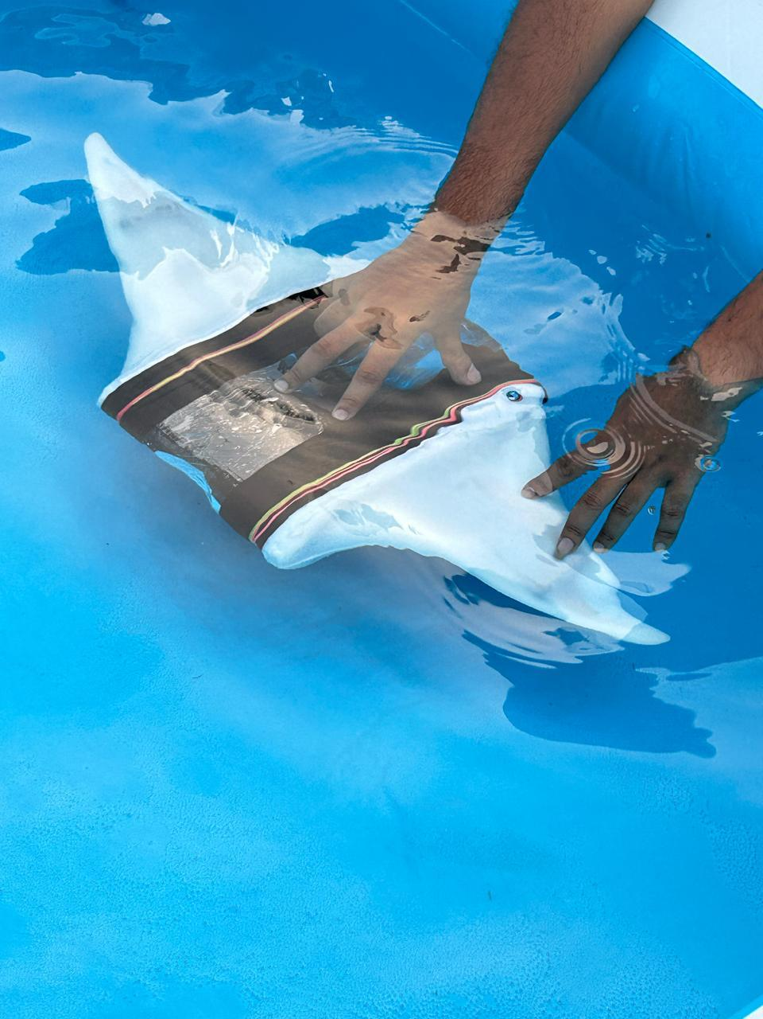
https://shorturl.at/yWwQX
Objectives of the Project:
Build a fully working prototype
Acquire a patent on our design
Systematically test the prototype
Publish our findings in a reputed journal
Deliverables
A fully working prototype
Design and documentation for the prototype
A design patent
Video Link: https://drive.google.com/file/d/1M4APnAaPdVwQEiCjTSisiodOv-OXEjBF/view?usp=sharing

